Slide 1
Virtualization
In
Data Center
Under the guidance of
Prof.Atul Negi
Presented by:
G Hareesh (18MCMB15)
Prathamesh Sanga(18MCMB08)

Slide 2
Contents
Introduction to Data center?
How does a data center do?
Why do we need Data centers?
Energy Consumption in Data Centers
Challenges and Why do we need virtualization in data center ?
Definition(virtualization in data center) and architecture
Virtualization of Hardware Resources as a Method of Power Savings in Data Center & Example
Data Analysis and Results & Comparison
Conclusion
References

Slide 3
Data centers are simply centralized locations where computing and networking equipment is concentrated for the purpose of collecting, storing, processing, distributing or allowing access to large amounts of data.
The elements of a data center break down as follows:
Facility
Support infrastructure(UPS,envir control,phy security system)
IT equipment(This includes servers, storage hardware, cables and racks as well as a variety of information security elements, firewalls)
Operations staff
Introduction to Data center?

Slide 4
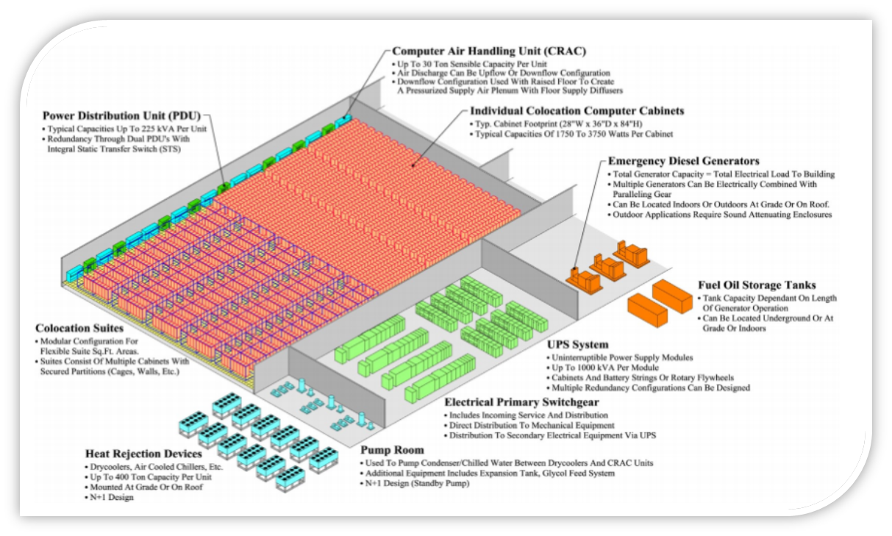

Slide 5
Datacenters powering Internet services are no longer simply a miscellaneous collection of machines co-located in a facility and wired up together.
The software running on these systems, such as Gmail or Web search services, execute at a scale far beyond a single machine or a single rack.
Datacenters are essentially very large devices that consume electrical power and produce heat.
The datacenter’s cooling system removes that heat—consuming additional energy in the process, whose heat must be removed as well.

Slide 6
How does a data center do?
Everyone needs their computer data including things like documents,customer details and financial information to keep it safe from theft fire or being accidentally deleted.
Small businesses
charities
Hard disks
Server

Slide 7
contd...
Current estimates of Energy bill computer cooling
world----1% (energy cosumed)
Europe---5%
Server facilities also need to be maintained around the clock by an IT professionals to ensure that they reliably
Cost
Servers

Slide 8
Contd...
To solve this problem most of the organization establised their own data centers for secure and supervised.
Some advanatages are
Temperature controlled
back up power supplies
shared facility

Slide 9
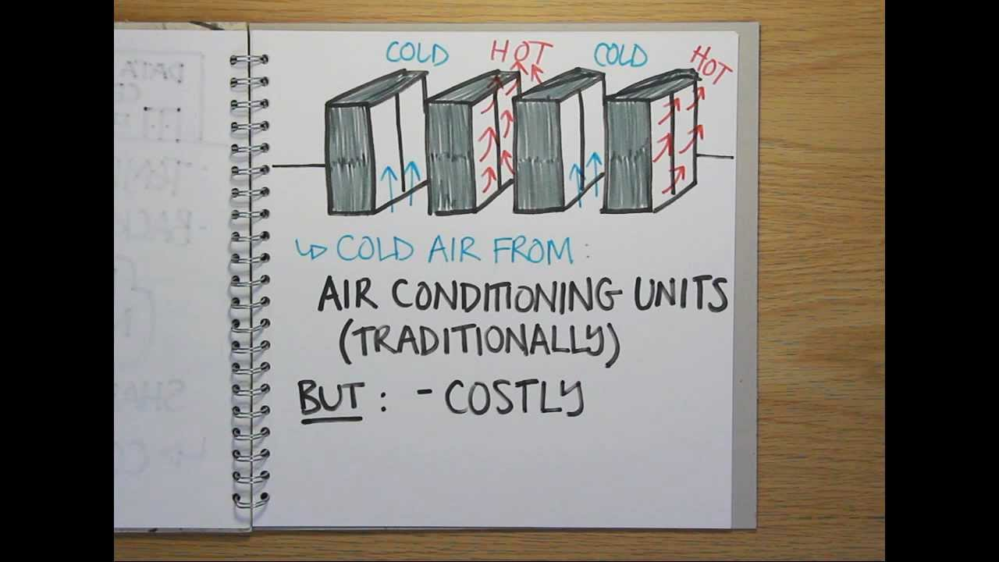

Slide 10
Why do we need Data centers?
Single electricity/space
Potential to expand
Avoiding cost of data loss.

Slide 11

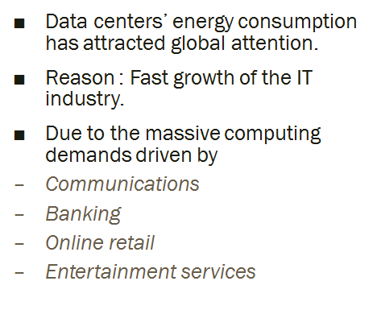
Energy Consumption in Data centers

Slide 12
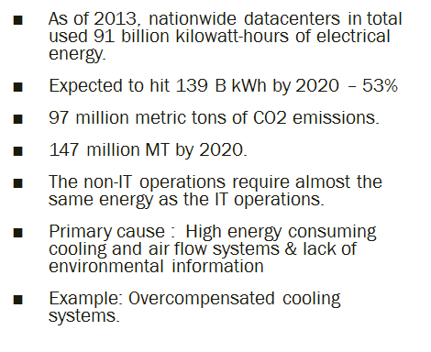
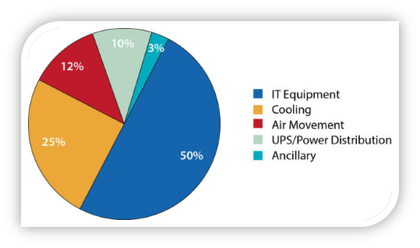
Energy Consumption in Data centers

Slide 13
Virtualization in Data Center

Slide 14
Data Center Challenges
Insufficient use of resources.
Power Consumption
Availability
Security

Slide 15
Why do we need virtualization in data center ?
Data centers are essentially very large devices that consume electrical power and produce heat. The data center cooling system removes that heat consuming additional energy in the process, whose heat must be removed as well. That’s why it consumes more power.
Because of more power consumption organisation need to pay more money.
To reduce paying more money, organisation using virtualization in data center.
Sometimes, which server you want to access that may go down and you have to wait until server run properly (that is availability)
Notes:
And your request is pending till server run properly
There is only physical server present

Slide 16
Definition
Data center virtualization is the process of designing, developing and deploying a data center on virtualization and cloud computing technologies.
It primarily enables virtualizing physical servers in a data center facility along with storage, networking and other infrastructure devices and equipment. Data center virtualization usually produces a virtualized, cloud and cloud data center.

Slide 17
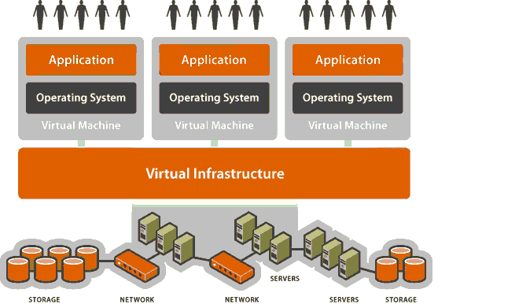
Architecture

Slide 18
Cont...
Physical infrastructure contains, storage, network, servers and other hardware devices. And all are connected together.
A virtual infrastructure is a software-based IT infrastructure being hosted on another physical infrastructure and optimize physical resources and drive costs down by hosting multiple virtual servers in a single host server.
This lean approach allows for sharing and distributing resources, which, in turn, promotes flexibility, scalability and lower total cost of ownership.
Every virtual machine contains any one operating system.

Slide 19
Cont...
Virtual infrastructure organizations works on IaaS and it contains,
Live migration,
Load balancing,
Live tracking (which hardware device is working) and many more.
How we can access virtualization data center,
Using, Web interface through which you can access data center
Using, Terminal through which you can access data center

Slide 20
Cont...
Benefits of a virtual infrastructure:
Scalable – Allows provisioning as many or as few logical servers as required, and users only pay for what they use.
Flexible – Allows for multiple server and networking configurations as compared to a hardwired physical infrastructure, which requires more capital and effort to change.
Secure – Allows more security to be layered on top of whatever security is already present in the virtual infrastructure because all traffic to the virtual infrastructure goes through the actual physical infrastructure.

Slide 21
Cont...
Load balancing – Allows software-based servers to share workloads easily and distribute them properly so that no single logical server is taxed more than the others.
Backup and recovery – Promotes easier backups because everything can be saved somewhere, allowing for quick recovery in other hosts if a few hosts are down. This is almost impossible with physical servers, which have to be revived before services can resume.

Slide 22
Virtualization of Hardware Resources as a Method of Power Savings in Data Center & Example
Let us compare energy consumption levels of a data center before and after virtualization.
A part of the existing infrastructure is replaced with the virtual one
Initially the energy consumption of five different servers has been observed from which the energy costs are calculated
Energy consumption of one enterprise class server with five virtual machines is observed

Slide 23
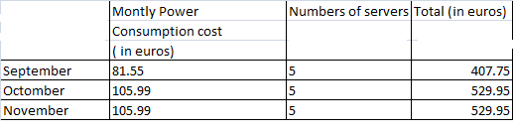
Data analysis and Results
Monthly Energy Costs for Five Physical Server Configurations

Slide 24
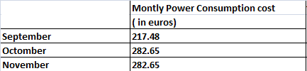
Contd...
Monthly Power Consumption Costs in Virtualized Environment

Slide 25
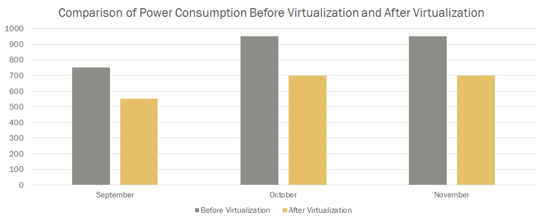
Comparison of Power Consumption

Slide 26
Conclusion
Virtualization reduces energy costs
Virtualization improves device utilization
Virtualization makes data center maintenance simple

Slide 27
References
https://www.techopedia.com/definition/29883/data-center-virtualizationhttps://www.techopedia.com/definition/29883/data-center-virtualization
https://www.techopedia.com/definition/30459/virtual-infrastructure

Slide 28
THANK YOU!

